Slide 1
PCA – Part 1
Standardization
Extract components
Notes:
We will discuss situations where it is appropriate to standardize the data before the analysis and what criteria we can use to determine how many principal components we should extract.

Slide 2
Standardize the data before PCA
Weight (kg) | Height (cm)
71 | 172
79 | 180
78 | 172
66 | 166
var = 37.7 | var = 33
SD = 6.14 | SD = 5.74
PC1 = 0.73*Weight + 0.68*Height
Notes:
When we have variables with different units, the units that we chose will affect how the variables in the PCA and handled. Let’s say that we like to use PCA to combine the two variables body weight and body height into one variable, PC1. If we calculate the variance of each variable, we see that the variance of the body weight is about 37.7 and that the variance of the body height is 33. The square root of the variance will give us the standard deviation. Although the two variables have different units in this example, it would be ok to combine them without normalization since they have about the same variance. If we would use PCA to combine weight and height into just one variable, PC1, we see that the weight for the body weight is 0.73 and 0.68 for the body height. Since the values of the weights are fairly similar, we know that both variables contribute to about the same extent to the linear combination.

Slide 3
Standardize the data before PCA
Weight (kg) | Height (cm) | Height (m)
71 | 172 | 1.72
79 | 180 | 1.8
78 | 172 | 1.72
66 | 166 | 1.66
var = 37.7 | var = 33 | var = 0.003
SD = 6.14 | SD = 5.74 | SD = 0.06
PC1 = 0.9999*Weight + 0.0079*Height
Notes:
However, let’s say that we would have expressed the body heights in meters instead of centimeters. Since the values are now relatively small, the variance becomes much smaller. By changing the unit from centimeters to meters, the variance of the variable height has been reduced from 33 to 0.003. If we would use PCA to combine the variables weight and height, now with the unit of meters, the values of the weights would be biased. As you see, we would put very little weight on the variable body height in this case. By changing the unit of the body height from centimeters to meters, very little information from this variable will contribute to the linear combination because the variance is relatively low when we use the unit meters.

Slide 4
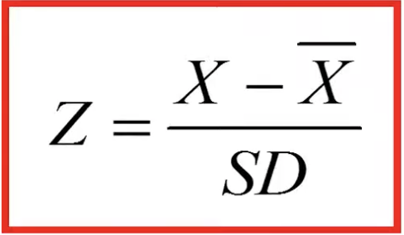
Standardize the data before PCA
Weight (kg) | Height (cm) | Height (m)
71 | 172 | 1.72
79 | 180 | 1.8
78 | 172 | 1.72
66 | 166 | 1.66
var = 37.7 | var = 33 | var = 0.003
SD = 6.14 | SD = 5.74 | SD = 0.06
Notes:
This example shows the importance of standardizing the data before we compute the PCA when our variables have different units or if the variance differs a lot between the variables. To standardize a variable, we subtract the corresponding mean from all the values of the variable, which will result in centered data. Then we divide the centered data by the standard deviation of the corresponding variable, which will give us the standardized variable.

Slide 5
Standardize the data before PCA
Diastolic BP | Systolic BP | Weight | Height
(mm Hg) | (mm Hg) | (kg) | (cm)
82.6 | 132.1 | 71 | 172
79.1 | 129.9 | 79 | 180
81.7 | 131.2 | 78 | 172
80.7 | 132.1 | 66 | 166
74.9 | 125 | 70 | 173
79.1 | 129.1 | 64 | 162
83.8 | 133.1 | 60 | 164
78.4 | 127 | 67 | 165
82.3 | 131.6 | 64 | 164
79.4 | 129.2 | 77 | 179
Mean | 80.2 | 130 | 69.6 | 169.7
SD | 2.6 | 2.5 | 6.6 | 6.4
Notes:
The dataset consist of four variables, the diastolic and systolic blood pressure, as well as the body weight and body height of 10 individuals. Let’s calculate the mean and the standard deviation of each variable. For example, the mean weight of the 10 individuals is 69.6 kg, and the standard deviation of the weight is 6.6 kg.

Slide 6
Standardize the data before PCA
Diastolic BP | Systolic BP | Weight | Height
(mm Hg) | (mm Hg) | (kg) | (cm)
0.93 | 0.82 | 0.21 | 0.36
-0.43 | -0.05 | 1.43 | 1.6
0.58 | 0.46 | 1.28 | 0.36
0.19 | 0.82 | -0.55 | -0.57
-2.05 | -1.98 | 0.06 | 0.51
-0.43 | -0.37 | -0.85 | -1.19
1.39 | 1.21 | -1.46 | -0.88
-0.7 | -1.19 | -0.39 | -0.73
0.81 | 0.62 | -0.85 | -0.88
-0.31 | -0.33 | 1.12 | 1.44
Mean | 0 | 0 | 0 | 0
SD | 1 | 1 | 1 | 1
Notes:
This is a standardized data. For example, this number tells us the person number one has a diastolic blood pressure, which is 0.93 standard deviations bigger than the mean. This value has been calculated by subtracting the mean of the diastolic blood pressure from the original value and divide by the standard deviation of the corresponding variable. Since standardizing the variables means that we center the data, the mean of the standardized variables should be equal to zero and since we divide by the standard deviation, the standard deviation of a standardized variable should be equal to one

Slide 7
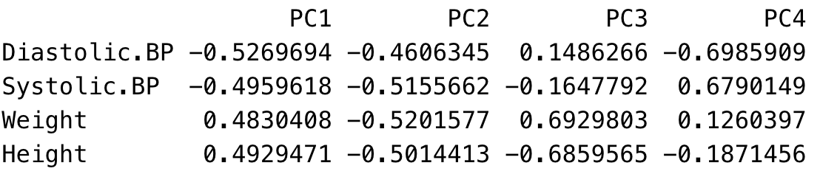
PCA
Data matrix (standardized data)
Component matrix
Diastolic BP | Systolic BP | Weight | Height
(mm Hg) | (mm Hg) | (kg) | (cm)
0.93 | 0.82 | 0.21 | 0.36
-0.43 | -0.05 | 1.43 | 1.6
0.58 | 0.46 | 1.28 | 0.36
0.19 | 0.82 | -0.55 | -0.57
-2.05 | -1.98 | 0.06 | 0.51
-0.43 | -0.37 | -0.85 | -1.19
1.39 | 1.21 | -1.46 | -0.88
-0.7 | -1.19 | -0.39 | -0.73
0.81 | 0.62 | -0.85 | -0.88
-0.31 | -0.33 | 1.12 | 1.44
PC1 = -0.53*DBP + (-0.5)*SBP + 0.48*Weight + 0.49*Height
PC2 = -0.46*DBP + (-0.52)*SBP + (-0.52)*Weight + (-0.50)*Height
Notes:
Now we discuss how many principal components that we should extract after we have computed the PCA. We will use our standardized data from our previous example. Note that we will get the same weights as if we compute the eigenvectors based on the correlation matrix, since the covariance matrix based on standardized data is identical to the correlation matrix based on the raw data. These weights are then used as coefficients in the linear combination of the standardized variables from which the scores of the first principal component are calculated whereas these weights are used to calculate the scores for principal component 2, and so on. Note that we used the standardized data, which is centered around zero, which means that we can directly multiply the centered variables by the weights to calculate the principal component scores.

Slide 8
PCA
Principal component scores are always reported as centered scores
Notes:
If we use the raw data instead, we should center the variables, by subtracting with the mean, when we calculate the scores.

Slide 9
PCA
PC1 = -0.53*DBP + (-0.5)*SBP + 0.48*Weight + 0.49*Height
PC2 = -0.46*DBP + (-0.52)*SBP + (-0.52)*Weight + (-0.50)*Height
Scores
PC1 | PC2 | PC3 | PC4
-0.62 | -1.14 | -0.1 | -0.14
1.73 | -1.32 | -0.16 | 0.14
0.26 | -1.35 | 0.65 | 0
-1.05 | 0.06 | -0.09 | 0.46
2.35 | 1.68 | -0.28 | 0
-0.59 | 1.43 | 0.23 | 0.16
-2.47 | -0.06 | -0.4 | -0.17
0.41 | 1.51 | 0.32 | -0.24
-1.58 | 0.19 | 0.03 | -0.09
1.58 | -1 | -0.2 | -0.13
Notes:
By using these two equations, we can calculate the scores for the first two principal components. For example, we see that the linear combination of these four variables based on the weights for principal component 1, results in a value of -0.62 for person number 1.

Slide 10
PCA
Data matrix (standardized data)
Scores
Diastolic BP | Systolic BP | Weight | Height
(mm Hg) | (mm Hg) | (kg) | (cm)
0.93 | 0.82 | 0.21 | 0.36
-0.43 | -0.05 | 1.43 | 1.6
0.58 | 0.46 | 1.28 | 0.36
0.19 | 0.82 | -0.55 | -0.57
-2.05 | -1.98 | 0.06 | 0.51
-0.43 | -0.37 | -0.85 | -1.19
1.39 | 1.21 | -1.46 | -0.88
-0.7 | -1.19 | -0.39 | -0.73
0.81 | 0.62 | -0.85 | -0.88
-0.31 | -0.33 | 1.12 | 1.44
PC1 | PC2 | PC3 | PC4
-0.62 | -1.14 | -0.1 | -0.14
1.73 | -1.32 | -0.16 | 0.14
0.26 | -1.35 | 0.65 | 0
-1.05 | 0.06 | -0.09 | 0.46
2.35 | 1.68 | -0.28 | 0
-0.59 | 1.43 | 0.23 | 0.16
-2.47 | -0.06 | -0.4 | -0.17
0.41 | 1.51 | 0.32 | -0.24
-1.58 | 0.19 | 0.03 | -0.09
1.58 | -1 | -0.2 | -0.13
Mean | 0 | 0 | 0 | 0
var | 1 | 1 | 1 | 1
Mean | 0 | 0 | 0 | 0
var | 2.41 | 1.45 | 0.1 | 0.04
Notes:
Remember that the standardized variables have the mean of zero and the variance or standard deviation equal to one. We see the scores, the transformed data, also have the mean of zero. However, the variances have changed since PCA has rotated the data in a way to maximize the variance of the first principal component. The first principal component has a variance of 2.41, whereas principal component 2 has a variance of 1.45 and so on.

Slide 11
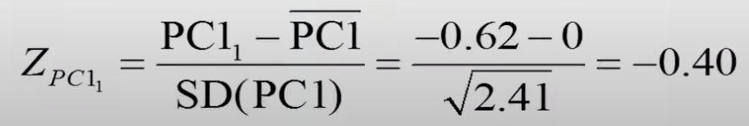
Standardized scores
PC1 | PC2 | PC3 | PC4
-0.4 | -0.95 | -0.3 | -0.65
1.11 | -1.1 | -0.5 | 0.69
0.16 | -1.12 | 2.05 | -0.01
-0.68 | 0.05 | -0.29 | 2.21
1.51 | 1.39 | -0.89 | 0
-0.38 | 1.19 | 0.72 | -0.8
-1.59 | -0.05 | -1.27 | -0.81
0.26 | 1.25 | 1.01 | -1.15
-1.02 | 0.16 | 0.1 | -0.43
1.02 | -0.83 | -0.64 | -0.65
Formula of standardized score
Mean | 0 | 0 | 0 | 0
var | 1 | 1 | 1 | 1
Notes:
If the score for the principal components have a standard deviation of 1, which will result in a variance of 1 then we know that the scores have been standardized.

Slide 12
How many components to extract
Select the smallest number of components that together hold about 80 – 90% of the total variance.
Use the Kaiser criterion, where we retain components with a variance (eigenvalue) greater than the average of the eigenvalues.
Use a scree plot.
Notes:
The purpose of PCA is to reduce the number of variables in the dataset. However, we started with 4 variables and after we ran PCA, we still have 4 variables so we should delete one or more principal components to reduce the number of variables. What criteria should we use to delete a principal component?

Slide 13
Method 1: 80 - 90% of the total variance
PC1 | PC2 | PC3 | PC4
-0.62 | -1.14 | -0.1 | -0.14
1.73 | -1.32 | -0.16 | 0.14
0.26 | -1.35 | 0.65 | 0
-1.05 | 0.06 | -0.09 | 0.46
2.35 | 1.68 | -0.28 | 0
-0.59 | 1.43 | 0.23 | 0.16
-2.47 | -0.06 | -0.4 | -0.17
0.41 | 1.51 | 0.32 | -0.24
-1.58 | 0.19 | 0.03 | -0.09
1.58 | -1 | -0.2 | -0.13
PC1 and PC2 explain 96.4% of the total variance.
The smallest number of components explain about 80 – 90% of the variance is 2
Reduce the dataset from 4 variables to only two variables
Var | 2.41 | 1.45 | 0.1 | 0.04
% var | 60.20% | 36.20% | 2.50% | 1.10%
Cum % | 60.20% | 96.40% | 98.90% | 100%
Notes:
Select the smallest the number of components that together hold about 80 -90% of the total variance. We calculate how much variance the first component holds by dividing 2.41 by 4, which is the total variance. The first principal component contains about 60% of the total variance. And the second component contains about 36% of the total variance. The first two principal components explain 96.4% of the total variance. Thus, the smallest number of components explain about 80 – 90% of the variance is 2.

Slide 14
Kaiser criterion
PC1 | PC2 | PC3 | PC4
-0.62 | -1.14 | -0.1 | -0.14
1.73 | -1.32 | -0.16 | 0.14
0.26 | -1.35 | 0.65 | 0
-1.05 | 0.06 | -0.09 | 0.46
2.35 | 1.68 | -0.28 | 0
-0.59 | 1.43 | 0.23 | 0.16
-2.47 | -0.06 | -0.4 | -0.17
0.41 | 1.51 | 0.32 | -0.24
-1.58 | 0.19 | 0.03 | -0.09
1.58 | -1 | -0.2 | -0.13
Kaiser criterion – retain components with a variance (eigenvalue) greater than the average of the variance (eigenvalue).
Variance of PC1 and PC2 > 1 (the average of variance)
Var | 2.41 | 1.45 | 0.1 | 0.04
% var | 60.20% | 36.20% | 2.50% | 1.10%
Cum % | 60.20% | 96.40% | 98.90% | 100%
Retain PC1 and PC2
Notes:
Since the variances of the different components are equal to the eigenvalues, these values also represent the corresponding eigenvalues. We have 4 standardized variables, total variance is 4. The mean of variance, or eigenvalues is 4/4=1

Slide 15
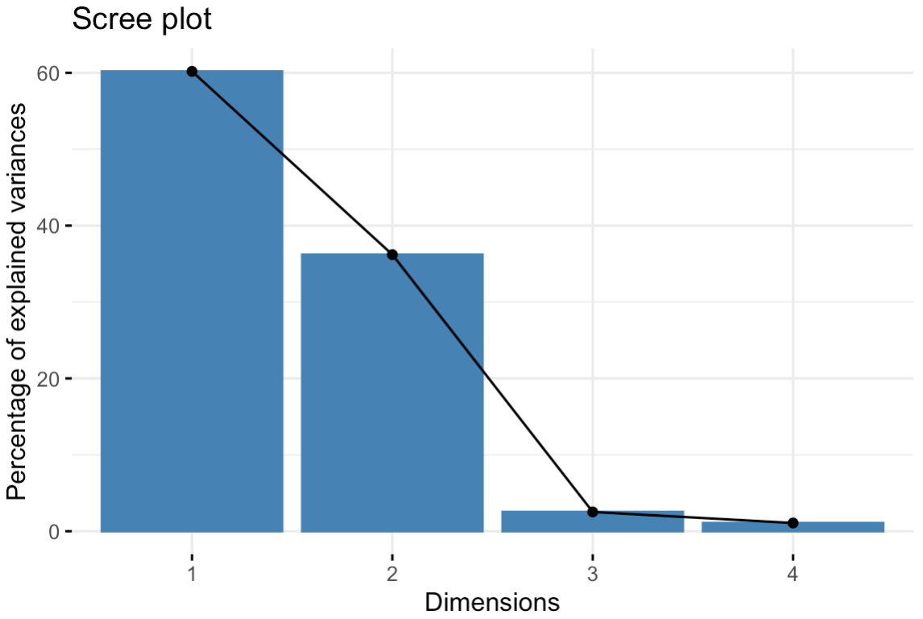
Scree plot
PC1 | PC2 | PC3 | PC4
-0.62 | -1.14 | -0.1 | -0.14
1.73 | -1.32 | -0.16 | 0.14
0.26 | -1.35 | 0.65 | 0
-1.05 | 0.06 | -0.09 | 0.46
2.35 | 1.68 | -0.28 | 0
-0.59 | 1.43 | 0.23 | 0.16
-2.47 | -0.06 | -0.4 | -0.17
0.41 | 1.51 | 0.32 | -0.24
-1.58 | 0.19 | 0.03 | -0.09
1.58 | -1 | -0.2 | -0.13
Var | 2.41 | 1.45 | 0.1 | 0.04
% var | 60.20% | 36.20% | 2.50% | 1.10%
Cum % | 60.20% | 96.40% | 98.90% | 100%
PC1 and PC2 are involved in the steep part of the curve
Retain PC1 and PC2
Notes:
By using Scree plot, we should only select the components that are involved in the steep part of the curve. There are 2 points are involved in the steep part of the curve, so we retain PC1 and PC2

Slide 16
References
https://www.youtube.com/watch?v=dh8aTKXPKlU&t=1s

